Slide 1
Session 9
Work with JSON Data

Slide 2
Objectives
Identify data types supported by JSON
Explain how to represent complex data with
JSON
Explain how to execute serialization and de- serialization of JSON with JavaScript
Describe tools and editors that can be used to work with JSON
Describe the syntax and schema of a JSON
document
Modern Markup for Data Interchange/Session 9
2

Slide 3
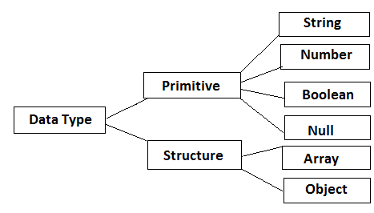
JSON Data Types 1-4
The two primary data types supported by JSON are primitive and structure.
In JSON, the type of a variable is recognized automatically during the parsing phase.
Modern Markup for Data Interchange/Session 9
3
Notes:
Primitive: nguyen thuy

Slide 4
JSON Data Types 1-4
It is a floating-point format (double
precision).
Does not accept Octal, hexadecimal, NaN, and Infinity values.
The types allowed are integer, fraction, and exponent.
Syntax {"string": number_value,
.......}
Number
A series of zero or other Unicode characters within double quotes and backslash escapes.
A character denotes a single character string.
Syntax {"string":"string value",
.......}
String
Modern Markup for Data Interchange/Session 9
4
Notes:
Fraction: phan so

Slide 5





JSON Data Types 2-4
Has only two values: true and false.
Using quotes for Boolean values treats them as String values.
Syntax {string: true/false,
.......}
Boolean
Null
Is an empty type.
A white space can appear between the characters in string values to make code more comprehensible.
Syntax {string:" ",....}
Object
White Space
Modern Markup for Data Interchange/Session 9
5
Notes:
comprehensible.: de hieu hon

Slide 6
JSON Data Types 3-4
Arrays allow storing various values of the same type in one variable.
Syntax [value, .......]
The characteristics of an array in JSON are:
It is a sequential collection of values, not necessarily of
the same type.
Indexing begins at 0 or 1.
It is enclosed in square brackets [ ].
Each value is set apart by comma (,).
Modern Markup for Data Interchange/Session 9
6

Slide 7
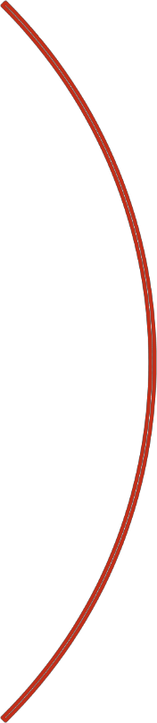






JSON Data Types 4-4
An object is an independent data type, having its own
attributes.
Syntax {string : value, .......}
The characteristics of an object in JSON are:
It is a non-sequential (having no order) set of key/value pairs.
It is enclosed in curly braces { }.
Each key/value pairs are set apart by comma (,) and every key
is proceeded by colon (:).
The keys are only strings, each differing from the other.
It is used when the key names are random strings.
Modern Markup for Data Interchange/Session 9

Slide 8

JSON Value
In JSON, value can be of any primitive and structure data type.
A JSON value can be a number, string, Boolean
such as true or false, null, object, or an array.
The following Code Snippet shows some examples
of JSON values:
var emp-no = 1234; var name = "Sherill"; var experience = null;
Modern Markup for Data Interchange/Session 9

Slide 9
Storing Different Values in Arrays
JSON arrays can store elements of different types. Following is a sample code:
[ 456, "Dog", 123, "Frog", true ]
Elements 0 and 2 in the array are of the type Number.
Elements 1 and 3 are of String type.
Element 4 is a Boolean type.
In JSON, arrays can also contain other arrays. This is called nesting of arrays.
Modern Markup for Data Interchange/Session 9

Slide 10
Data Structures Supported by JSON
In JSON, the built-in data structures can be used to develop other data structures.
The two data structures supported by JSON are:
Collection of Name/Value Pairs
Ordered List of Values
Supported by different programming languages, in the form of objects.
Includes arrays, lists, and vectors.
Modern Markup for Data Interchange/Session 9

Slide 11
Collections: Maps, Sets, and Lists
The elements in a list follow a defined order and copies or duplicates are allowed.
The elements are positioned in a specific location.
List
Collection without duplicate
elements.
In JSON, it is not possible to avoid replicas, however, the parser removes the duplicates while serializing the data.
Collections
Set
Map
A type of data structure that mainly aids in quick searching of data.
Accepts data in the form of key and value pairs and each key is distinct.
Modern Markup for Data Interchange/Session 9

Slide 12
JSON Schema
JSON schema specifies the rules that defines the structure of a JSON document.
The two main aspects that define why a JSON schema
language is required are:
To specify JSON
data structures
To validate JSON
data structures
Handy when the JSON-based Web services need to be made accessible to a large audience
Handy when validating JSON documents from other applications
Helps to avoid parsing an invalid data structure in valid JSON
documents
Modern Markup for Data Interchange/Session 9
Notes:
Handy : thuan tien, de van dung

Slide 13
Schema Overview
Application/schema+json is the media type described
by JSON schema and prescribes the design of JSON documents.
It offers provision for defining the structure of the documents with respect to the permitted values, descriptions, and decoding connections to other resources.
The JSON schema format is arranged in the following individual definitions:
Core Schema Specification
Explains a JSON structure and states
valid elements in it.
Hyper Schema Specification
Explains the elements in a JSON structure that can be considered as hyperlinks.
Modern Markup for Data Interchange/Session 9
Notes:
Prescribe: chi dinh, qui dinh
Provision : dieu khoan
Respect to : lienquan toi

Slide 14
JSON Comments
JSON does not have any provision for documentation or comments.
However, comments are still supported by a few JSON parsers and must be provided within /* … */.
{
"id":2,
"title":"The fallen Hero", /* This books
is about Harvey Dent */
"noOfCopies":14, "tags":[
"BatMan",
"Gowtam"
],
}
Modern Markup for Data Interchange/Session 9

Slide 15
Creating and Parsing JSON Messages with JavaScript
The JSON.stringify() method allows converting a
JavaScript object into a JSON String.
The JSON.parse() method allows parsing a JSON object using JavaScript.
It converts a JSON String to an object in JavaScript.
Start by defining a string in JSON format, using the method for conversion, and then looping through the attributes for printing its values.
Modern Markup for Data Interchange/Session 9

Slide 16
JSON with Developer Tools on Browser
There are many plugins or extensions that help in validating and formatting a JSON document or a JSON HTTP response.
One such extension in Firefox is JSONView, which allows viewing a JSON document.
With JSONView the JSON document is displayed in the browser.
JSONView displays the raw text even though the JSON document has errors.
Chrome also offers JSONView for validating a JSON document.
For modifying the JSON values during runtime, it is recommended converting the JSON document to a JavaScript object before using the built-in browser developer tools.
Modern Markup for Data Interchange/Session 9

Slide 17
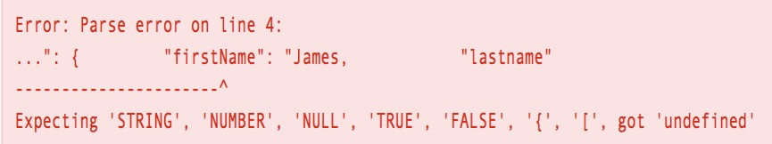
Online Tools and Editors
JSONLint is an open source project that helps in validating JSON data.
Using JSONLint or any other online tool is easy, as it only
requires copying the JSON data to its online editor.
In case of an error, the output similar to the following is displayed:
Output shows the line number and the type of error that occurred.
If everything is fine, the following output is displayed:
Modern Markup for Data Interchange/Session 9

Slide 18
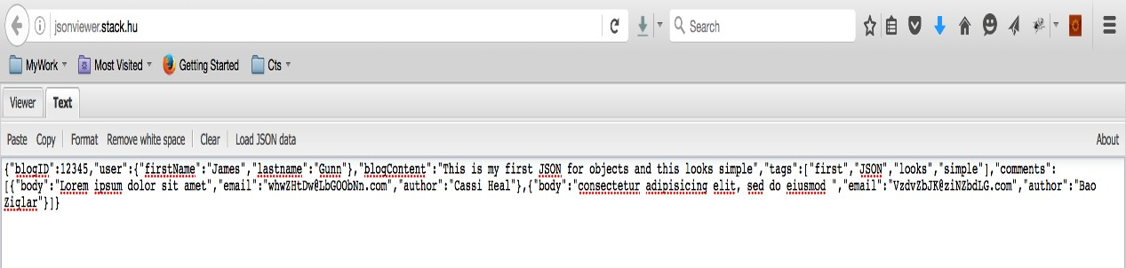
Online JSON Viewers 1-2
While working with JSON, it is often required to use a JSON viewer to see how the document will look in the browser.
One of the most widely used is jsonviewer.stack.hu and JSON text can be directly copied to this online viewer.
The following screenshot shows the jsonviewer.stack.hu:
Modern Markup for Data Interchange/Session 9

Slide 19
Online JSON Viewers 2-2
o Another way of supplying data to the viewer is by clicking
Load JSON data.
The viewer takes data from the URL you provide and loads data from that source.
Once the JSON code is visible in the viewer, clicking Format
formats the code.
Modern Markup for Data Interchange/Session 9

Slide 20
Summary
The two primary data types supported by JSON are primitive and structure.
The primitive types are String, Number, Null, and
Boolean. The structure types are Array and Object.
Arrays allow storing various values of the same type in one variable.
An object is an independent data type, having its own
attributes.
In JSON, arrays can also contain other arrays. This is called nesting of arrays.
The two data structures supported by JSON are Collection of Name/Value Pairs and Ordered List of Values.
JSON schema specifies the rules that defines the structure
of a JSON document.
JSON does not have any provision for documentation or comments.
JSONLint is an open source project that helps in
validating JSON data.
Modern Markup for Data Interchange/Session 9

